Slide 1
User Manual

Slide 2
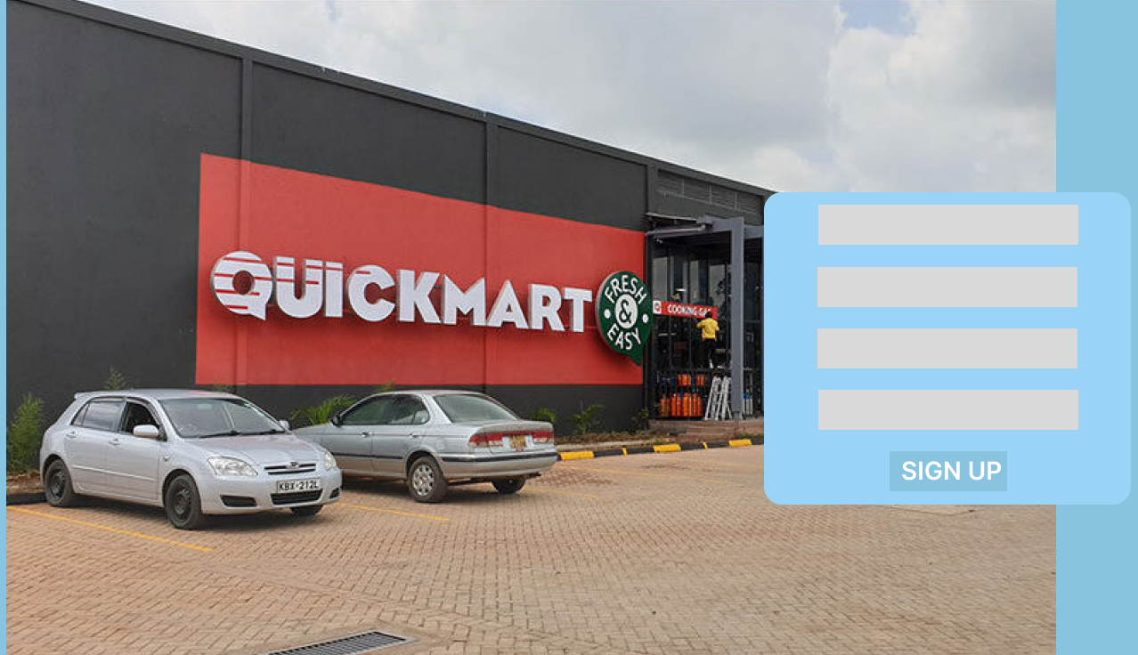
Upon your first visit to our site, you must sign up for an account. Please click sign up- then follow the prompts with the proper information

Slide 3
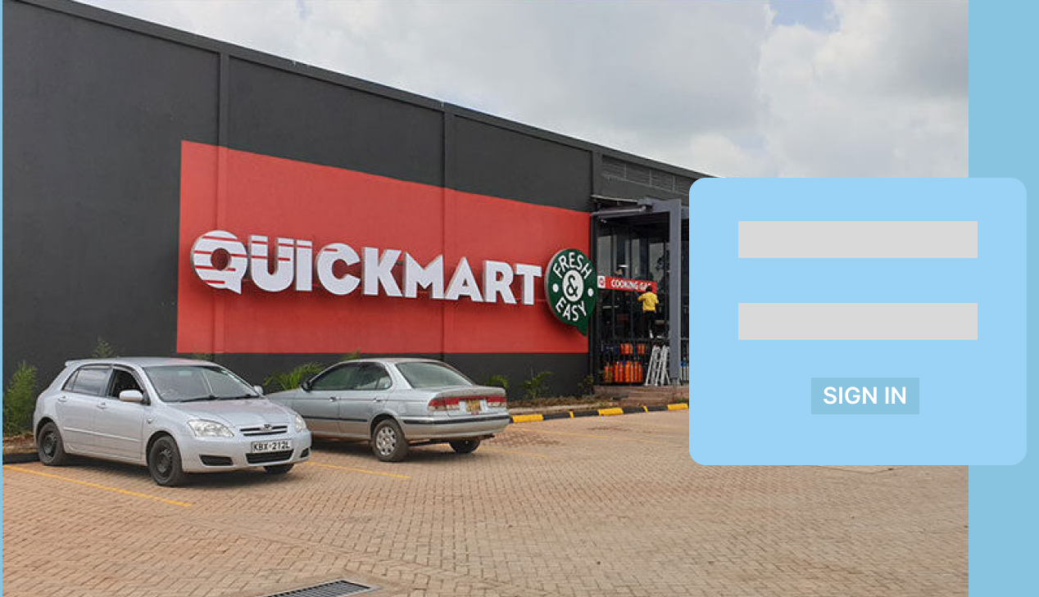
Alternatively, if you have already created an account, simply sign in.
If you need assistance with your login information, please reach out to your system rep and they will be able to assist.

Slide 4
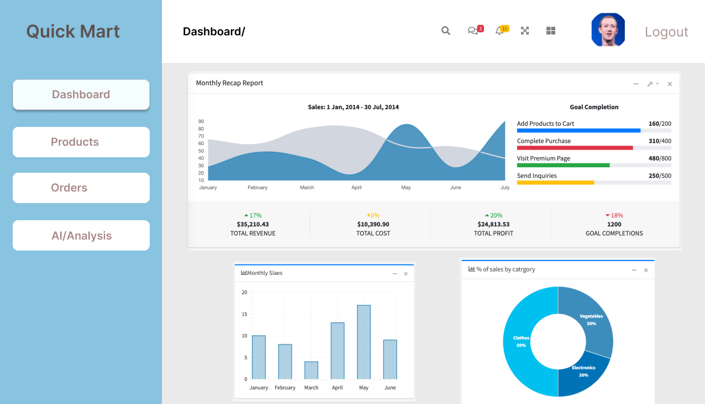



Once signed in your home page will display your dashboard, consisting of; monthly recap report, sales and percentage of sales by category. There is also a sidebar menu with other options to choose from.

Slide 5
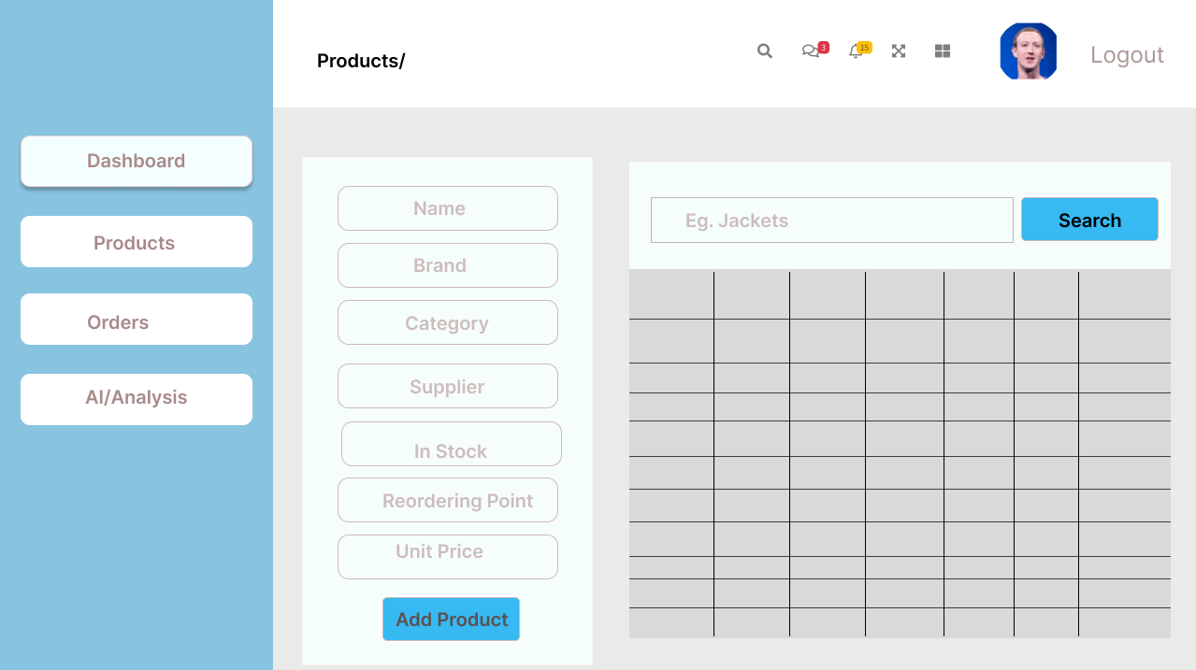

After selecting products, you will be taken to your product information page.
If you wish to add a product, simply entered the requested information and click 'Add Product'.
If you are searching for a previously inputted product, you can use the search bar for its name on top.

Slide 6
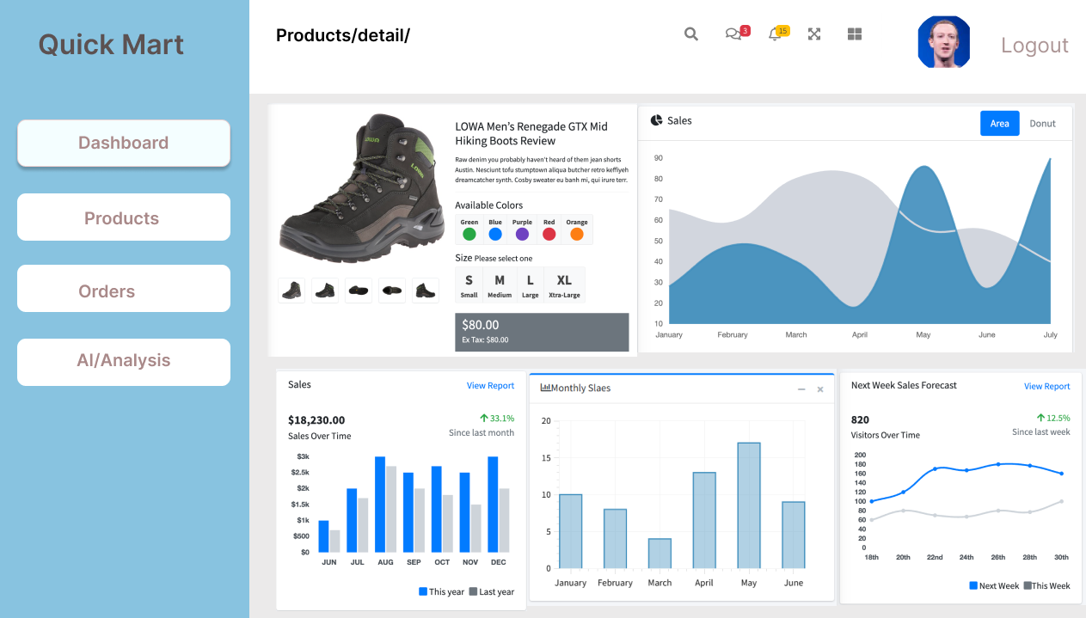

Once finding a product, you can select it and will be redirected to this next page. Here will show the same reporting tools as found in the dashboard - on this product alone.
Also, you can customize the product's options, descriptors, title, cost, etc.

Slide 7
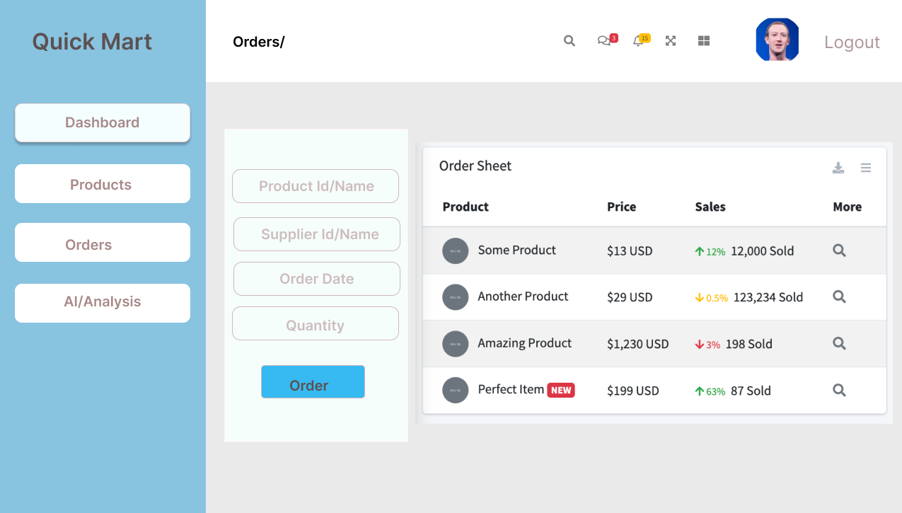


If selecting the 'orders' tab you will be able to find your recent orders.
If you are searching for a specific or an older order, you must fill out the information on table and click 'Order'.

Slide 8
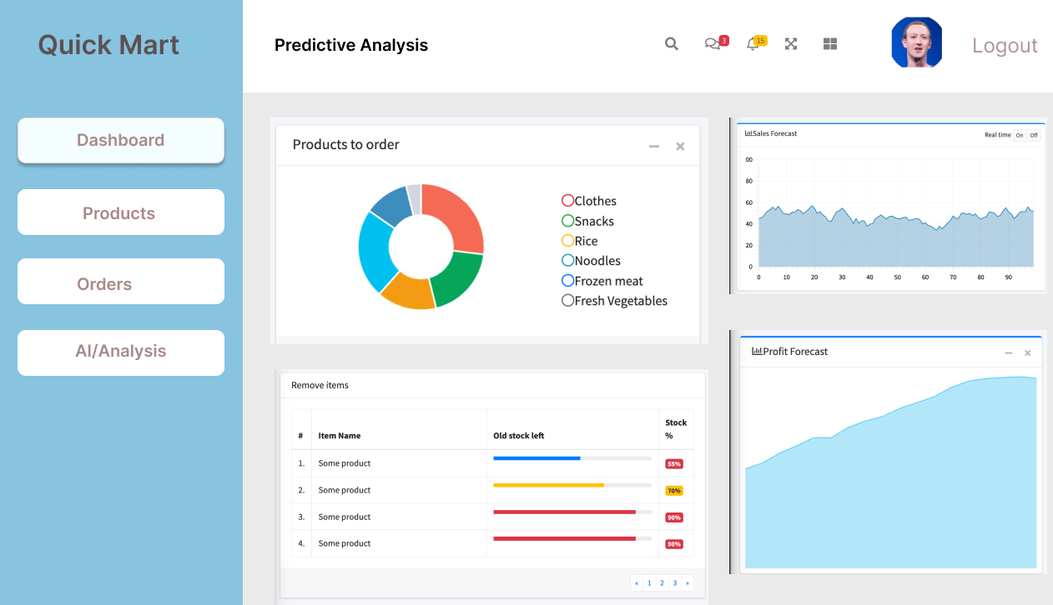


The last menu option will be the AI/Analysis page.
Here will predict which products you may need to order. Which products are underperforming in sales and the corresponding sales and profit forecasts.

Slide 9
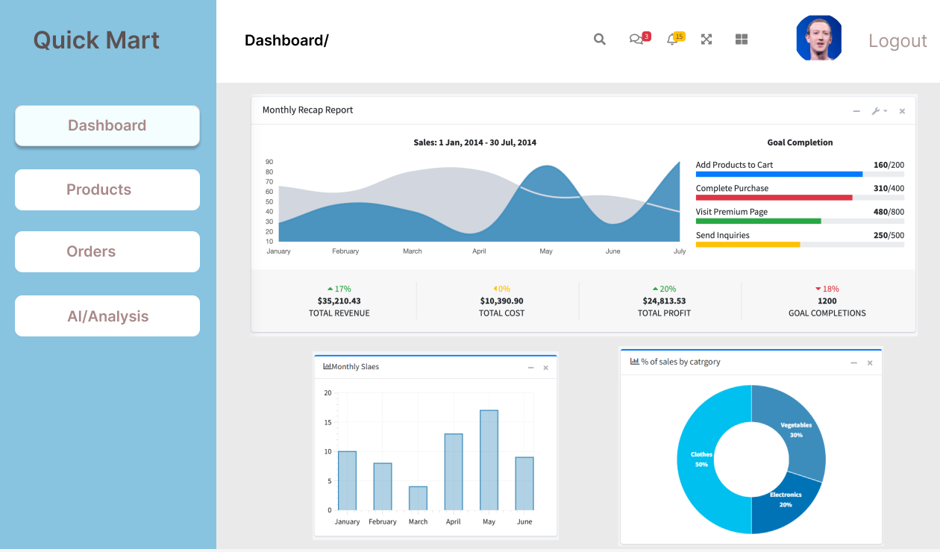

Lastly, if you wish to customize your profile picture simply click on the photo (or the + button if none) to edit/add a photo.
Remember to always click 'Logout' once leaving this page.

